Slide 1
AngularJS & Node.js
An introduction to the world of the web run by JavaScript

Slide 2

AngularJS - the super-heroic JavaScript MVW framework “HTML Enhanced for web apps!”

Slide 3
Web History
A time before AngularJS and JavaScript Frameworks

Slide 4
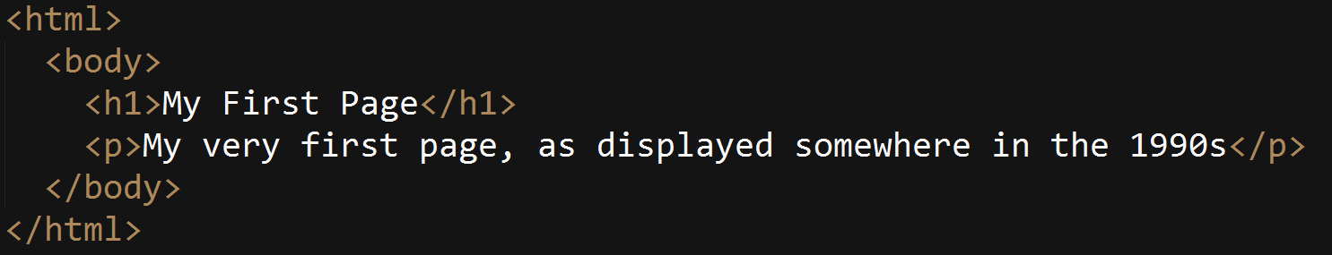
Static HTML

Slide 5
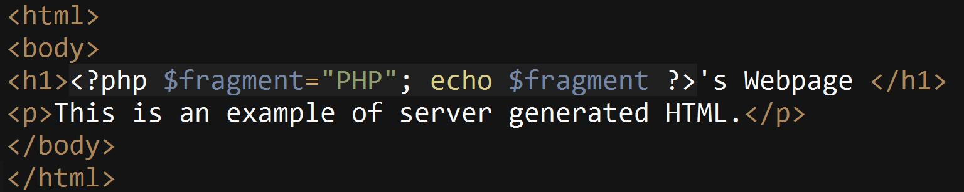
Server Generated (PHP)

Slide 6
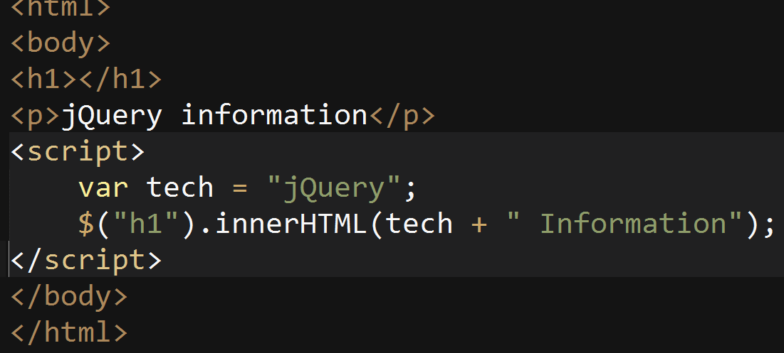
Client Side JavaScript

Slide 7
What is AngularJS?
A structured framework to help you build web applications in a way that is consistent, fast and succinct.
A way of extending HTML, expressing it in a way that makes sense for your application.
Eliminates clumsy DOM manipulation from code all over your web applications
Allows modularization and segregation of views
A client side JavaScript framework

Slide 8
A word about architecture
MVC (Model View Controller) This is a standard pattern that everyone understands.
MVVM (Model View ViewModel) Makes use of a binder markup to express the model to the view in a way that is easy to read and removes boilerplate.
MVW (Model-View-Whatever) This is a paradigm that says “whatever works for you.”, as quoted by Igor Minar (A developer of AngularJS)

Slide 9
MVW?
Today, AngularJS is pretty close to the MVVM model described before. We will explore this next, but the important mantra AngularJS tries to put on is simple:
Having said, I'd rather see developers build kick-ass apps that are well-designed and follow separation of concerns, than see them waste time arguing about MV* nonsense. And for this reason, I hereby declare AngularJS to be MVW framework - Model-View-Whatever. Where Whatever stands for "whatever works for you". Igor Minar

Slide 10
What does Angular HTML look like?
<div id="inner" ng-app="myApp">
<p>Hello World! My name is {{name}}</p>
</div>

Slide 11
jQuery
AngularJS
HTML <div id="inner"
<p id=“name”><p>
</div>
JavaScript var name = “Albert” $(“name”).text(“Hello world!” My name is “ + name);
HTML <div id="inner" ng-app="myApp">
<p>Hello World! My name is {{name}}</p>
</div> JavaScript $scope.name = “Albert”;

Slide 12
Results
They’re the same: just a single line in your web browser
“Hello World! My name is Albert”
However, did you notice that jQuery was controlling the data (model) AND the view? The code became mixed
That might not seem so exciting.. But consider this

Slide 13
AngularJS Example
HTML <div id="inner" ng-app="myApp">
<div ng-repeat="person in people" style="font-size: 44px; background-color: lightgray; color: black">{{person.name}} <b>{{person.sex}}</b> </div>
</div>
JavaScript $scope.people = [];
$scope.people.push({name: "David Brown", sex: "Male"});
$scope.people.push({name: "Angele Hamel", sex: "Female"});
$scope.people.push({name: "Eugene Zima", sex: "Male"});

Slide 14
jQuery Example
HTML <div id="inner""> </div>
JavaScript var people = [];
people.push({name: "David Brown", sex: "Male"});
people.push({name: "Angele Hamel", sex: "Female"});
people.push({name: "Eugene Zima", sex: "Male"}); people.forEach(function(person) { $(“#inner”).html(“<div>…</div> <b>…</b>); }); // Update code

Slide 15

The output for both is similar
However, without some structure… things get messy really quickly! What if “people” had changed somewhere else in the code? Need to make sure we update the HTML with another jQuery call.
What if the HTML changed? The code needs updating.
It’s not clear looking at the view what is really going on. There’s no hint at what could be happening. It’s not expressive.

Slide 16
Angular provides data binding
If an underlying variable changes on what is known as the “$scope” (your “M” in MVW, your model) then the view is automatically updated.
Added an entry to the person array in real time? No problem!
Angular is letting you worry about your logic without worrying about the messy details of staying in sync

Slide 17
Writing Angular

Slide 18
Model
$scope.building = [ name: “Arts Building", code: “C “,
colour: “Blue “, }
Creates a model that is contained within a single file. All data for a single view is self contained and managed, rather than sprinkled through monolithic modules.

Slide 19
View
<h2>{{building.name}}</h2> <button ng-click=“change_name()”>Change Name</button>
A self contained view that expresses exactly what it will do, and what will happen for each element in the hierarchy.

Slide 20
Controller
function myCtrl( $scope ) { $scope.building = [ name: “Arts Building", code: “C “,
colour: “Blue “, } $scope.change_name = function() {
$scope.building.name = “Science Building”; };
}
The controller describes exactly what a particular view can do and how it will interact with the data.

Slide 21

Result

Slide 22
What else does AngularJS give you?
Views and Routing.
Services.
Testability.
Filters.
HTTP Accessibility
Tight integration with modern browsers

Slide 23

Filters
Filters allow us to reduce, manipulate and operate on arrays of data by simply describing what we want to do without manipulating the model.

Slide 24
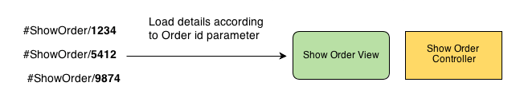
View Routing
AngularJS will provide automatic routing and parameter passing for views based on URL’s; so you can worry less about routing and more about designing an application.

Slide 25

An event-driven, non-blocking I/O JavaScript implementation built for servers based on Chrome’s JavaScript V8 engine

Slide 26
Why Node.JS?

Slide 27
Traditional Model
In your average web server, you will serve up static HTML that has been generated by a server.
Each client typically will get a dedicated thread
I/O, such as database I/O will block on this thread and wait to return the data for the request. Costs a lot of time!
Results are eventually returned, and the client now has what they want

Slide 28
Moving to aynsc & a data oriented world
In Node.Js, there’s just a single request thread and a single worker queue with an event loop.
When a database call is hit, a “promise” is returned to begin where it left off when the CPU is free (i.e: non-blocking)
Results are returned just-in-time but don’t steal system resources away from everyone else whilst this is going on

Slide 29
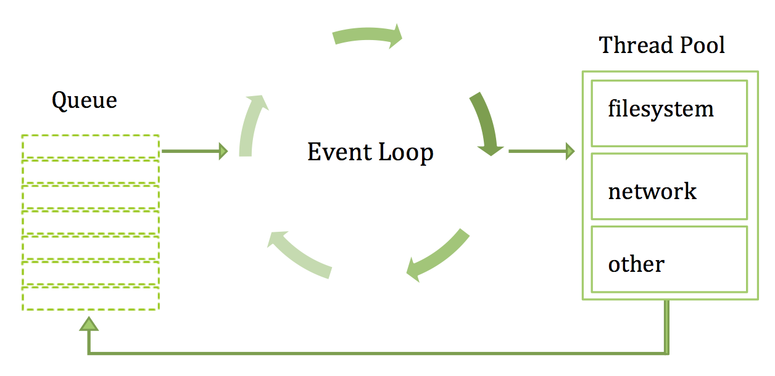

Slide 30
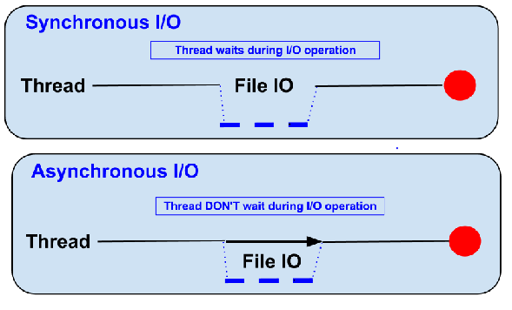

Slide 31
So what? Just use more threads!
Threads are expensive. Even if you use a pool, allocating a thread will cost usually around 2 megabytes of memory. When using one per client, that’s already 2MB per client. Hardly scalable.
Concurrent programming is hard. There’s entire PHD thesis’s and research on parallel programming. Parallelizing tasks such as I/O is almost impossible given current architectures.
Event loops given consistency. The even loop uses a queue; FIFO

Slide 32
Real-time & Responsive
Node.js is good at providing real-time feedback and responsive information to users.
It has great socket implementations, ideal for real-time chats.
Current popular implementations in PHP rely on long polling. Apache not designed for long persistent connections.
It’s great for working with schema-less data… a dynamic language like JS!
Code can be shared between client and server

Slide 33
Good Uses
Single Page Applications. An application that demands responsiveness and serving up data. We will build one of these later.
JSON REST API’s. Since Node.js is JavaScript, it is ideal for interacting with JSON. As we saw earlier, AngularJS makes heavy use of JSON for the model. This makes the two quite attractive as an option for pairing.
Streaming Data. Node.js excels at streaming information where things like PHP, Ruby and Python cannot. It’s sophisticated asyc. I/O and stream protocols make it a tough competitor.
Web Scrapers. With libraries like Cheerio and jQuery, there’s a whole wealth of information available.

Slide 34
Bad Uses
Scaling CPU bound, rather than I/O bound. Remember, Node.js operates on the principal that a lot of work is I/O bound and thus is idling wasting resources. However, if you’re building applications that actually do a lot of computations… you’re cheating yourself! Node.js is not good at these.
Maturity is required. Node.js is young! There are problems. There are bugs. There isn’t every fancy package out there in NPM.
Response / Request / CRUD. If your application is a simple request-response application, Ruby on Rails might be better or something PHP, Python or ASP.NET offers.

Slide 35
What does it look like?
my_http = require("http");
my_http.createServer(function(request,response){
response.writeHeader(200, {"Content-Type": "text/plain"});
response.write("Hello World");
response.end();
}).listen(8080);

Slide 36
Show me the async!
my_http = require("http");
my_http.createServer(function(request,response){
fs.readFile(‘test.json', 'utf8', function (err,data) { response.write(data); });
}).listen(8080);
No blocking I/O, no blocking threads! The file will be returned when the operating system has read it all. Node.js is free to server other requests in the meanwhile.

Slide 37
What else does it buy me?
NPM. The Node Package Manager is filled with rich tools that help power the web. Things like jQuery, express, JSON parsers, socket.io and more make interacting with the modern web a snap.
Tools built for a modern web. Built with sockets in mind – you can build a fully functioning chat application with real time communications in 50 LOC!
Unified tools. You can be a full stack developer!

Slide 38
Fast Prototyping
Node.js is written in JavaScript and JavaScript allows a lot of flexibility without a lot of rigor.
If your goal is to write a fast, scalable application in a small amount of time then Node.js might just be an option.
Sending JSON is as simple as a single method call and interacting with NoSQL like MongoDB is also deceptively simple.
var db = require(‘monk’);
var courses = db.get(‘courses’); courses.find({}, function(courses) { res.send(courses); });

Slide 39
Workplace

Slide 40
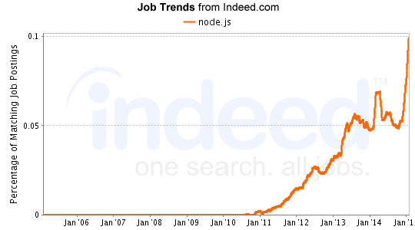
Node.js
Using today as a random sample, 150 jobs have been posted to jobs.nodejs.org in the last 24 hours.
Nearly 4500 in the last 30 days
Indeed.com shows rapid growth in the job market

Slide 41
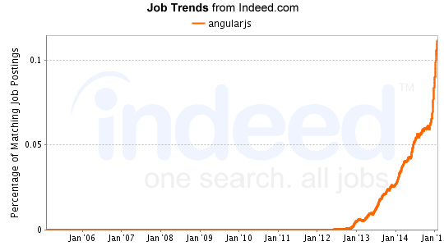
AngularJS
AngularJS developers are listed as a minimum
$70, 000 / year salary right now @ Indeed.com.
The trend is growing exponentially but demand cannot be met
Over 5,000 jobs in the last month at Indeed.com

Slide 42
DEMO TIME!
We’ll be building a search for WLU to find what courses a professor will be teaching throughout a school term

Slide 43
Questions?
Anything at all!

